Slide 1
Corfu
Yasminne Veruzábová 7.A

Slide 2
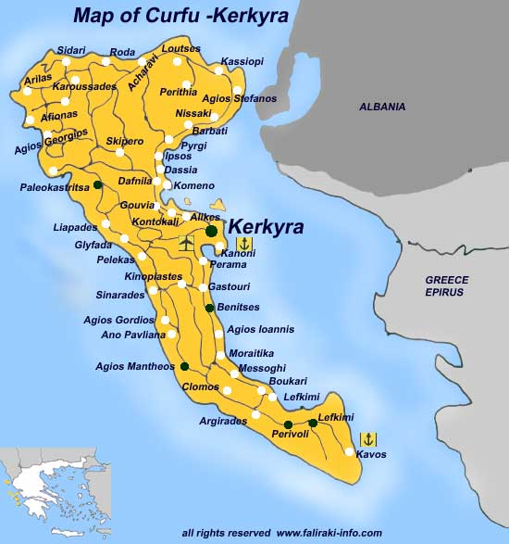
About island
Corfu is one part of Greece islands. It „neighbors" are Albania and Greece.
The capital city off Corfu is Kerkyra. There live 40 000 people.
In all Corfu there live more than 110 000 people.

Slide 3
Paleokastrica
Paleokastrica is located in the northwest coast of Corfu.
Paleokastrica long was considered one of the most beautiful villages in Corfu and it is a renowned Greek beauty spot.
At the northern part of Paleokastrica (Agios Spyridon) lies the 12th century monastery of Theotokos. In this monastery is a museum. There are holy and precious relics of the monastery.

Slide 4
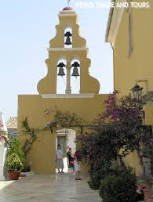
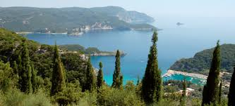
Paleokastrica

Slide 5
Achelleion
Achelleion is a palace which was built in Corfu by Empress of Austria Elisabeth of Bavaria, also know Sisi.
After Elisabeth's death, the German Kaiser Wilhelm II purchased Achilleion in 1907 from her heirs and used it as a summer residence. During Kaiser Wilhelm's visits a lot of diplomatic activity used to take place in Achilleion and it became a hub of European diplomacy.

Slide 6
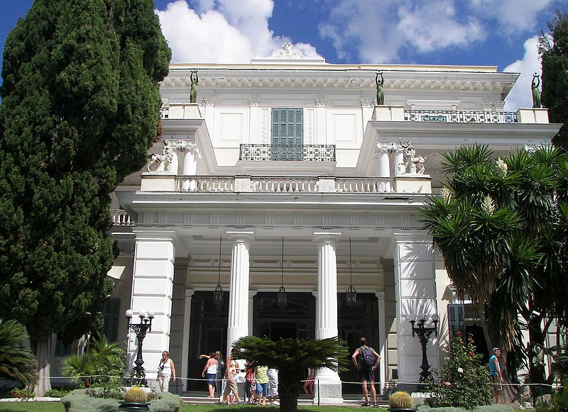
Achelleion

Slide 7
Mouse island
Pontikonisi island is home of the monastery of Pantokrator . The white staircase of the monastery resembles from afar a mouse tail. The island got its name from this architectural quirk: Mouse island.

Slide 8
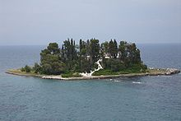
Mouse island

Slide 9
The Saint Spyridon Church
The Saint Spyridon Church is a Greek Orthodox church located in Corfu. It was built in the 1580s. It houses the relics of Saint Spyridon and it is located in the old town of Corfu. It is the most famous church in Corfu.

Slide 10
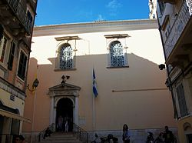
The Saint Spyridon Church

Slide 11
The New Fortress
The New Fortress of Corfu is a Venetian fortress built on the hill of St. Mark in Corfu.
The current buildings which exist within the fortress were built by the British during their rule of the island (1815–1863).

Slide 12
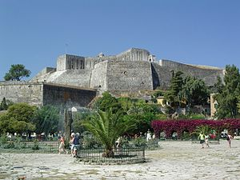
The New Fortress

Slide 13
Thank you for attention

